Slide 1
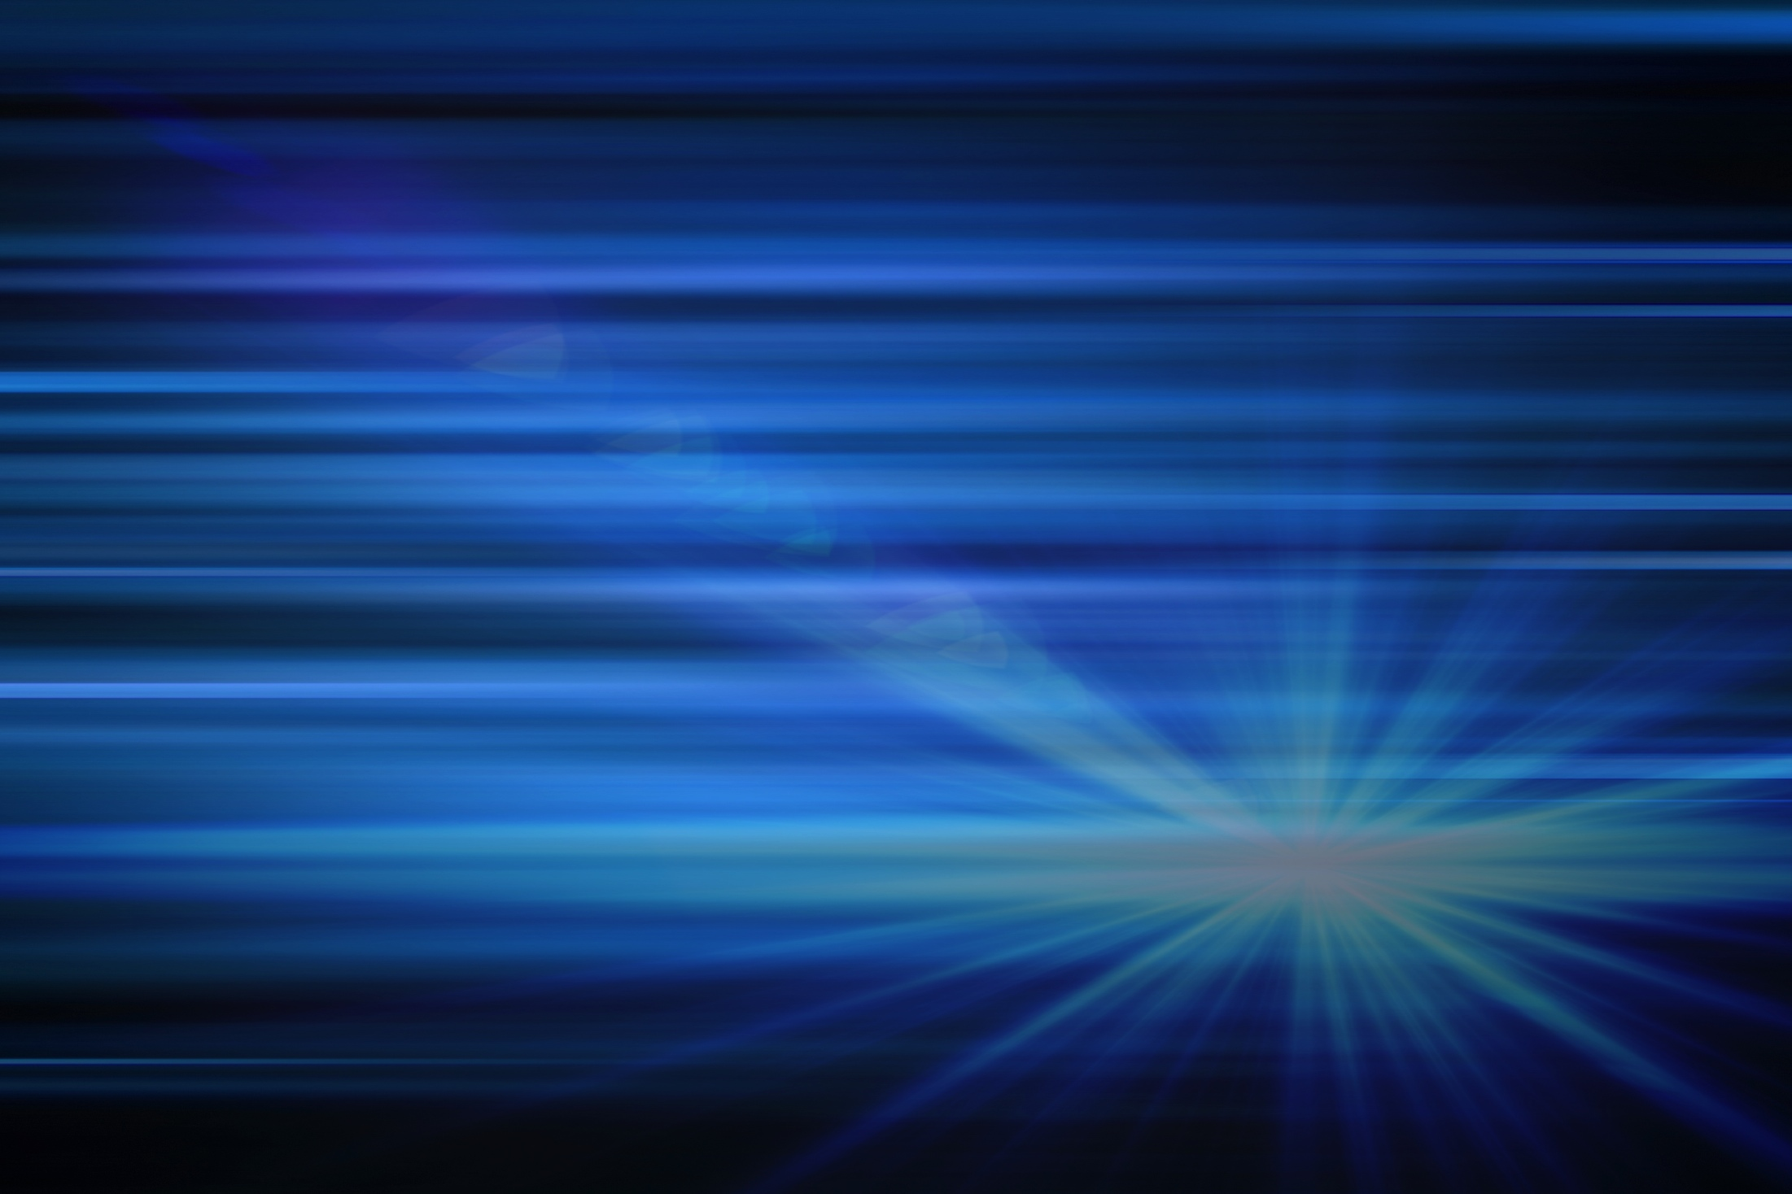
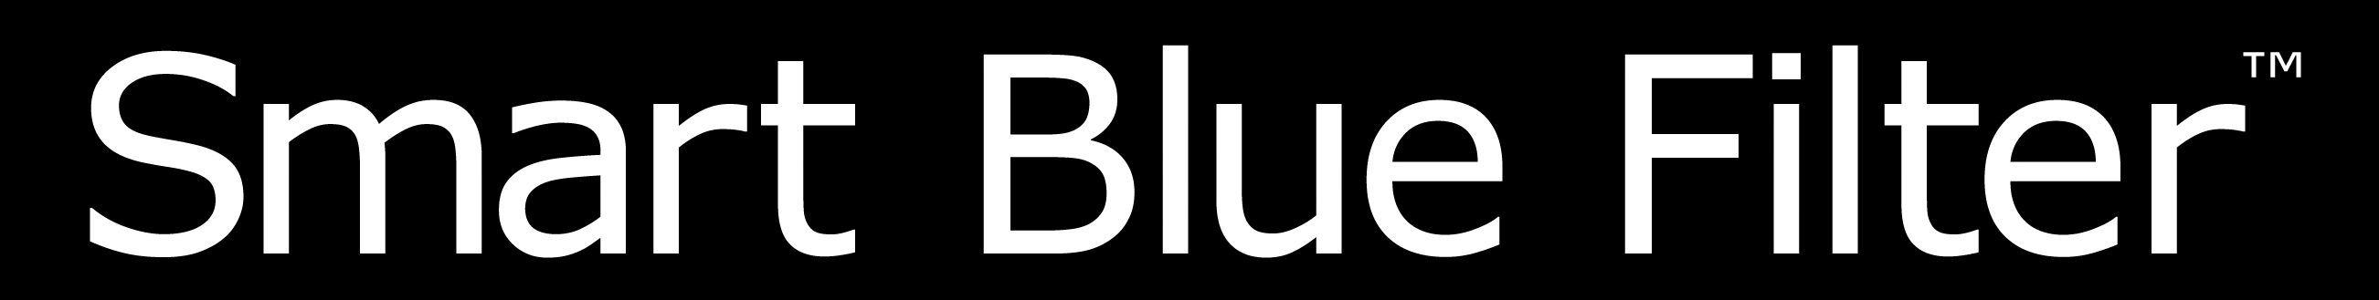
Liban Obsiye
Essilor Brand Sales Consultant
NOT FOR DISTRIBUTION – DO NOTDISCLOSE OR COPY

Slide 2

AGENDA
    Understanding Blue Light
    Smart Blue Filter™
    Smart Blue Filter™ Products
    Product Availability
Source:
*Arnault E. Barrau C, Nanteau C. Gondouin P, Bigot K, et al. “Phototoxic Action Spectrum on a Retinal Pigment Epithelium Model of Age-Related Macular Degeneration
Exposed to Sunlight Normalized Conditions.” PLoS ONE 8(*); e71398.doi:10.1371398.August 23,2013.
**National Institues of Health National Eye Institute. Facts about Age-Related Macular Degeneration. Retrieved from: https://nei.nih.gov/health/maculardegen/armd_facts
NOT FOR DISTRIBUTION – DO NOT DISCLOSE OR COPY
Notes:
At Essilor, we are committed to exploring the long term impact of prolonged exposure to Harmful Blue Light and will continue our research so that we can better understand its impact on the eye. One thing we know for sure, is that there are no beneficial effects of Blue-Violet Light.
We also know that harmful Blue Light has been linked to retinal disorders such as age-related macular degeneration (AMD), which is the leading cause of blindness for adults over the age of 50 in the US. There has been a lot of research and discussion regarding this topic in the optical industry, and there appears to be several contributing factors regarding macular degeneration including:
Age
Genetics
Long term exposure to Harmful Blue Light
Lifestyle (e.g. smoking)
Obesity
Lack of antioxidants in the daily diet

Slide 3

HARMFUL BLUE LIGHT
has been linked to retinal disorders such
as age-related macular degeneration (AMD)*, which is a leading cause of vision loss in
adults over the age of 50.**
Source:
*Arnault E. Barrau C, Nanteau C. Gondouin P, Bigot K, et al. “Phototoxic Action Spectrum on a Retinal Pigment Epithelium Model of Age-Related Macular Degeneration
Exposed to Sunlight Normalized Conditions.” PLoS ONE 8(*); e71398.doi:10.1371398.August 23,2013.
**National Institues of Health National Eye Institute. Facts about Age-Related Macular Degeneration. Retrieved from: https://nei.nih.gov/health/maculardegen/armd_facts
NOT FOR DISTRIBUTION – DO NOT DISCLOSE OR COPY
Notes:
At Essilor, we are committed to exploring the long term impact of prolonged exposure to Harmful Blue Light and will continue our research so that we can better understand its impact on the eye. One thing we know for sure, is that there are no beneficial effects of Blue-Violet Light.
We also know that harmful Blue Light has been linked to retinal disorders such as age-related macular degeneration (AMD), which is the leading cause of blindness for adults over the age of 50 in the US. There has been a lot of research and discussion regarding this topic in the optical industry, and there appears to be several contributing factors regarding macular degeneration including:
Age
Genetics
Long term exposure to Harmful Blue Light
Lifestyle (e.g. smoking)
Obesity
Lack of antioxidants in the daily diet

Slide 4
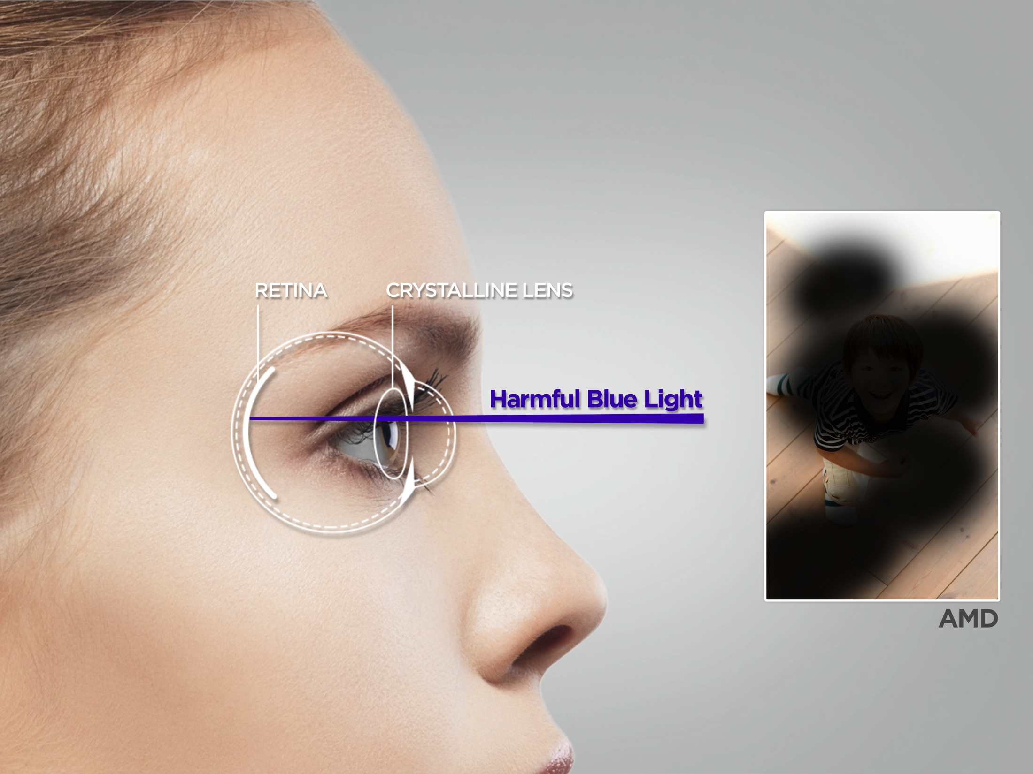
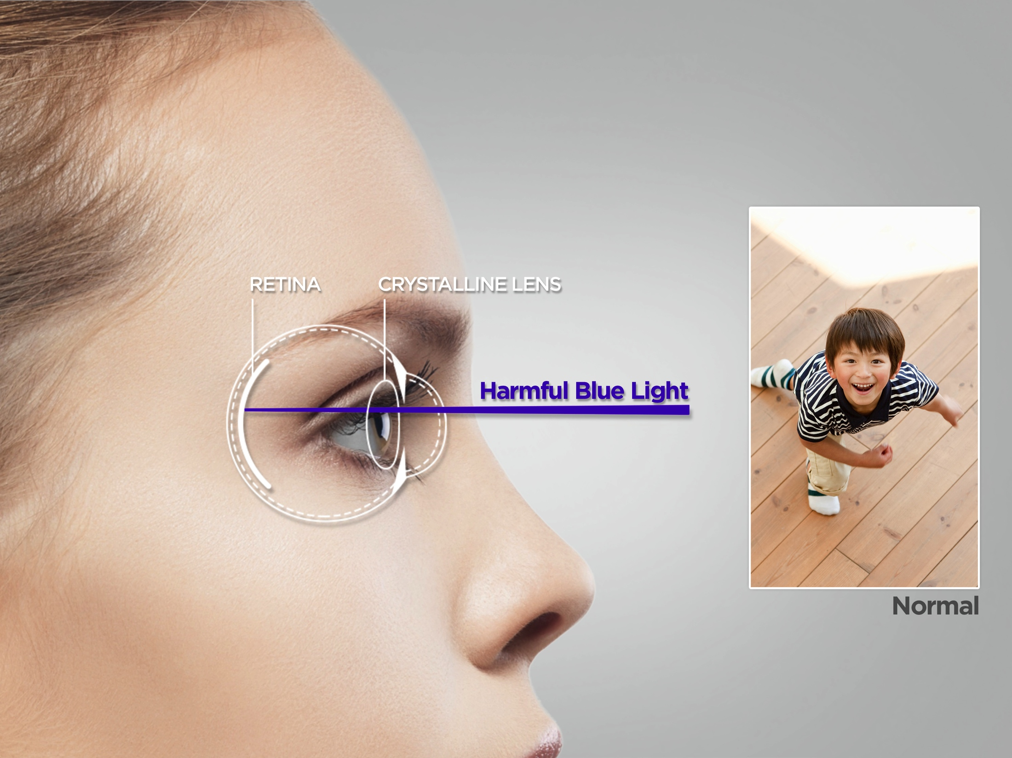
HARMFUL BLUE LIGHT
has been linked to Retinal cell death and AMD
NOT FOR DISTRIBUTION – DO NOT DISCLOSE OR COPY
Notes:
But how has Harmful Blue Light been linked to AMD? Simply put, Harmful Blue Light generates a damaging toxic substance (toxic reactive oxygen species). When patients are younger, their eyes are able to get rid of the toxic substances, but as they age, their eyes’ ability to get rid of toxins decreases. This process, in which damage accumulates over a lifetime, has been linked to diseases like AMD. (Source: Blue Light Roundtable, NYC. A report on Blue Light Hazard: New Knowledge, New Approaches to Maintaining Ocular Health. March 16, 2013.)
As an eyecare professional, there is not much you can do to change a patient's age or genetics, but you can help reduce the Harmful Blue Light for patients that are at risk of developing AMD.

Slide 5
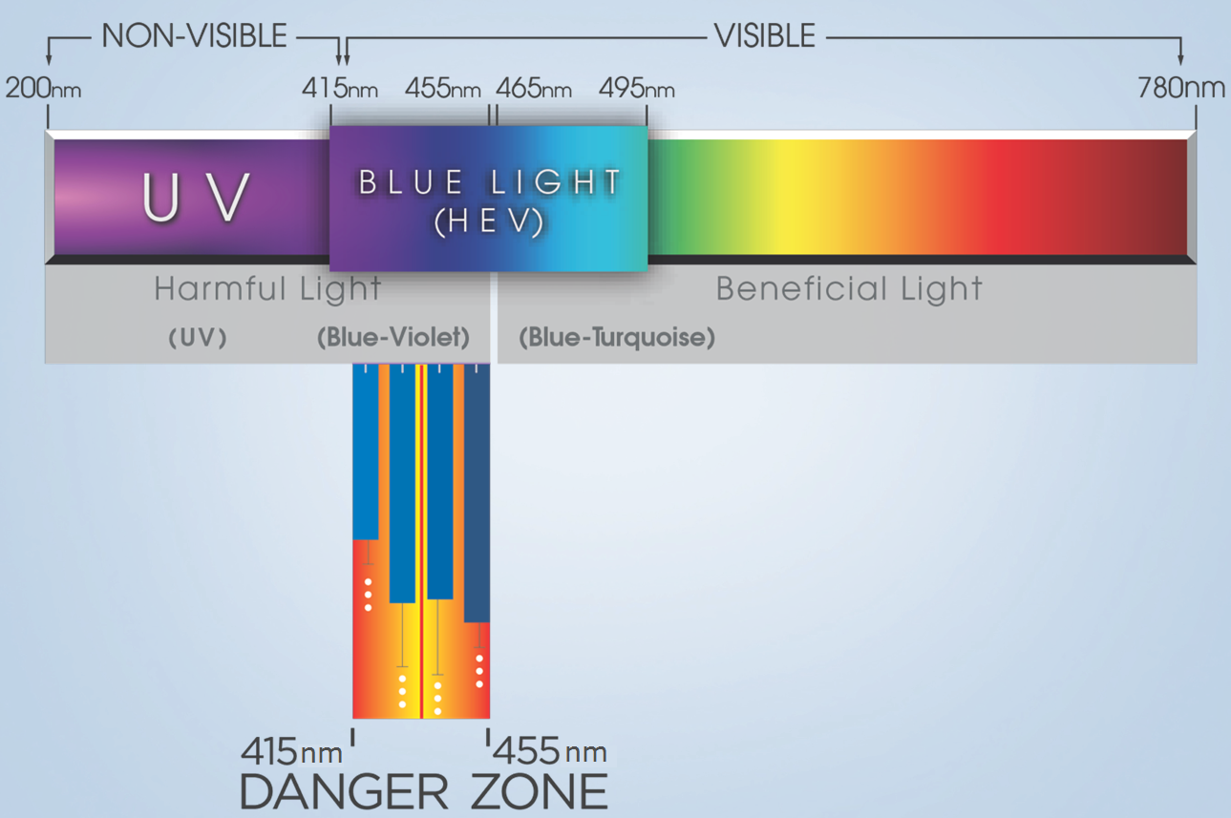
UNDERSTANDING THE LIGHT SPECTRUM
ELECTROMAGNETIC LIGHT SPECTRUM
NOT FOR DISTRIBUTION – DO NOT DISCLOSE OR COPY
Notes:
On the screen you can see the light spectrum. All of the colors/wavelengths of the rainbow are found here. As you move from left to right, you can see the non-visible/harmful light and how this progresses to visible/beneficial light.
UV Light is harmful, and that is why our Crizal UV™ products help protect patients eyes from both front side UV and backside UV. But when it comes to Blue Light, we needed to understand what portion is harmful and what is beneficial. To do this, researchers from Essilor’s Paris R&D team joined forces with scientists from the Paris Vision Institute to develop a unique illumination system that allowed us to determine what areas of the light spectrum are most harmful. By exposing swine cells to narrow 10nm bands of light, scientists found that most retinal cell death occurred when exposed to the Blue-Violet Light bands between 415nm-455nm, with a peak at 435nm. This breakthrough has helped Essilor to create lenses that reduce the level of exposure to the harmful portion of the Blue-Violet Light spectrum by 20%, while permitting the rest of the visible spectrum (in particular the Blue-Turquoise light) to enter the eye at a normal level.
(Source: Blue Light Roundtable, NYC. A report on Blue Light Hazard: New Knowledge, New Approaches to Maintaining Ocular Health. March 16, 2013.)

Slide 6
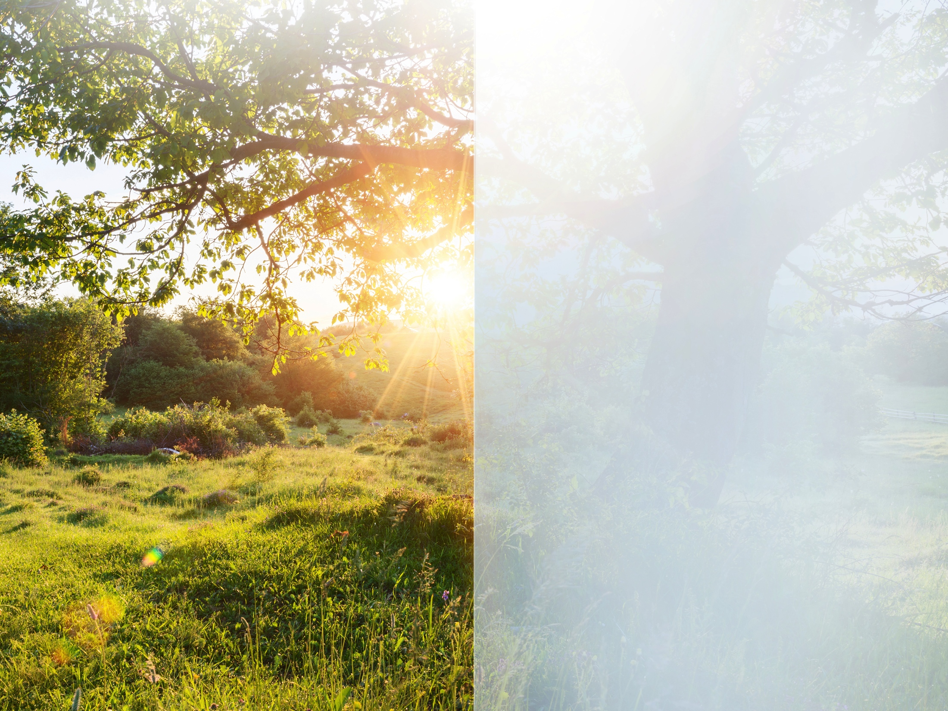
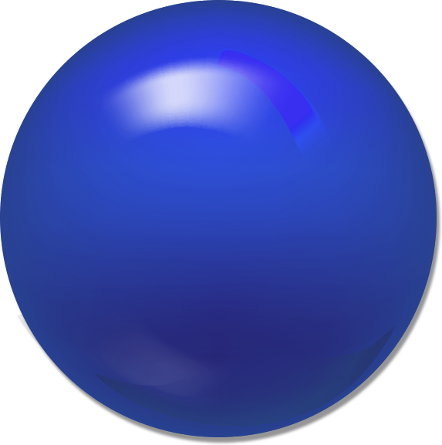
OUTSIDE
Harmful Blue Light
is 500X more intense
than inside
The sun emits Harmful Blue
Light all year long, and in
all weather conditions
The sun is the largest singular source of Harmful Blue Light
The sun scatters light through
the atmosphere and is up to
500x more intense than the Harmful Blue Light we are
exposed to inside
NOT FOR DISTRIBUTION – DO NOT DISCLOSE OR COPY
Notes:
Harmful Blue Light is everywhere, but let’s focus on outdoor exposure first:
While the amount of Harmful Blue Light exposure from sunlight varies depending on a person’s geographic location, the time of day, and the weather, the sun remains the single largest source of Harmful Blue Light. The sun scatters light through the atmosphere and is up to 500x* more intense than the Blue Light we are exposed to indoors.
Consider this:
- A laptop screen (even set to its brightest setting) has around 200-300 LUX*
- A very well lit indoor space (like your practice) has at most 500 LUX
A sunny day has around 110,000-120,000 LUX
In other words, the Harmful Blue Light you encounter outside is 200-500x more intense than the Harmful Blue Light you experience inside!
*Lux is the SI (system of units) of illuminance, which is equal to one lumen per square meter.

Slide 7
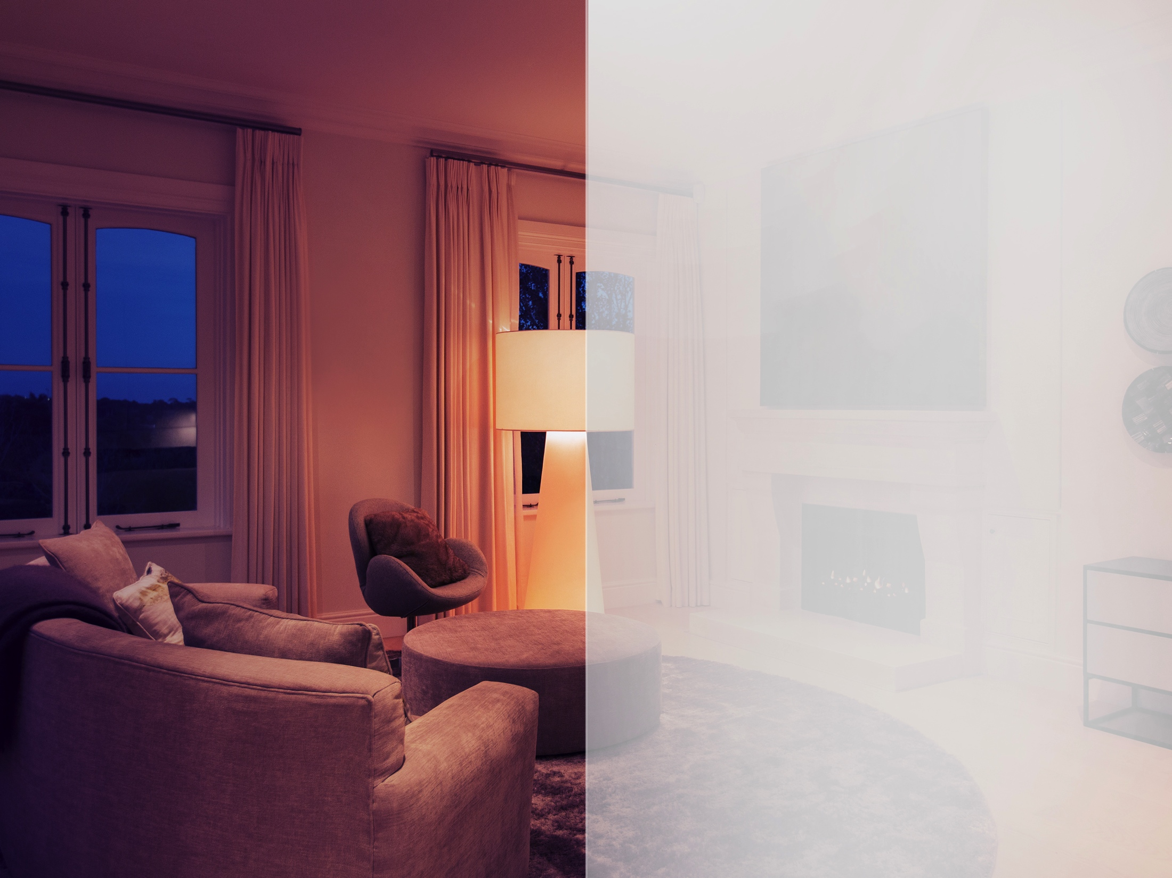
INSIDE
Harmful Blue Light
is everywhere
Blue Light is emitted by many
indoor sources of light such as LED lamps and compact fluorescent light bulbs (CFLs)
Harmful Blue Light is also present in modern digital devices like computer screens, tablets, and many smart phones.
As the U.S. moves toward more energy-efficient light sources (LEDs), Blue Light surrounds
us even more
NOT FOR DISTRIBUTION – DO NOT DISCLOSE OR COPY
Notes:
Now let’s take a look at the Harmful Blue Light patients are exposed to indoors:
As I mentioned earlier, exposure to high energy Blue Light is likely to increase significantly as people convert from incandescent and halogen lighting to CFLs and LEDs, which produce a far higher portion of Harmful Blue Light. (Source: Diana L. Shechtman, Blue Light Hazard.)
Another source of Harmful Blue Light is the technology we use. Digital devices of all kinds emit Harmful Blue Light from their screens. A few examples of digital sources include: Smartphone's, tablets, e-readers, desktop/laptop computers, video games, and televisions.
Here are some facts regarding digital use by patients today:
1 in 4 children spend more than 3 hours each day on a digital device
30% of adults spend 9+ hours on digital devices each day
72% of adults are unaware of the dangers of Harmful Blue Light
Patients look at their phone over 100+ times a day
(Source: The Vision Council, “2015 Digital Eye Strain Report.” Hindsight Is 20/20/20: Protect Your Eyes from Digital Devices.)

Slide 8
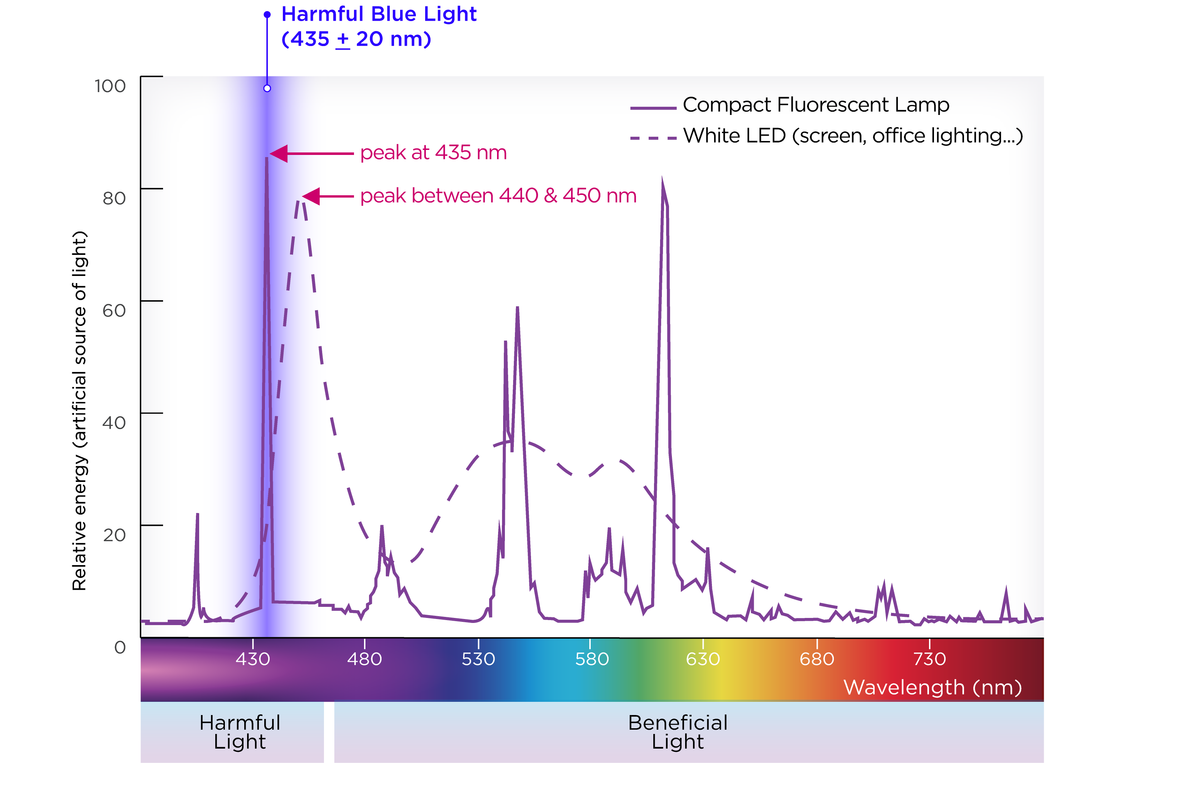
INSIDE HARMFUL BLUE LIGHT
NOT FOR DISTRIBUTION – DO NOT DISCLOSE OR COPY
Notes:
This chart illustrates the level of energy emitted by both CFL and LED lights. Although there is more than one peak for these types of light, there is only one area that is harmful and that is between 415-455nm. As you can see both types of light peak within this harmful range. This means that they are emitting a high amount of energy in the wavelengths that are harmful to our eyes.
Now that we understand the sources of Harmful Blue Light, and what wavelengths are most dangerous, we need to understand the damage it may cause patients’ eyes.

Slide 9
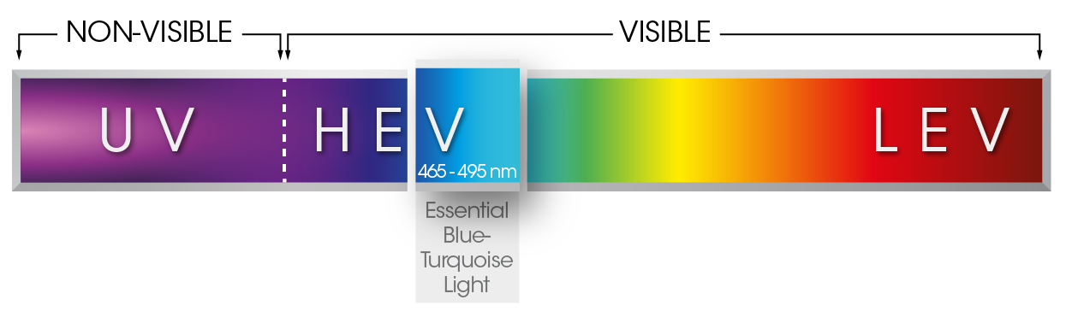
LIGHT IS IMPORTANT FOR VISION & EVERYDAY HEALTH
Beneficial Light
  Blue-Turquoise light (465nm-495nm) plays an essential role in regulating the sleep/wake cycle, memory, cognitive performance, and other contributing factors to general wellness.
  Rest of the visible light spectrum is essential for color perception & acuity
NOT FOR DISTRIBUTION – DO NOT DISCLOSE OR COPY

Slide 10
"The potential connection between blue-light phototoxicity and retinal diseases such as AMD suggests that reducing blue-light exposure would be beneficial to long-term ocular health."
(Source: Blue Light Hazard: New Knowledge, New Approaches to Maintaining Ocular Health, Report of a Roundtable March 16, 2013; New York City, NY, USA.)
NOT FOR DISTRIBUTION – DO NOT DISCLOSE OR COPY

Slide 11
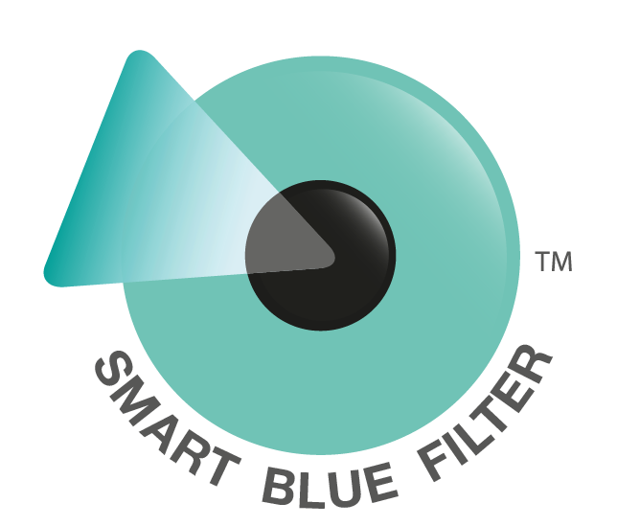
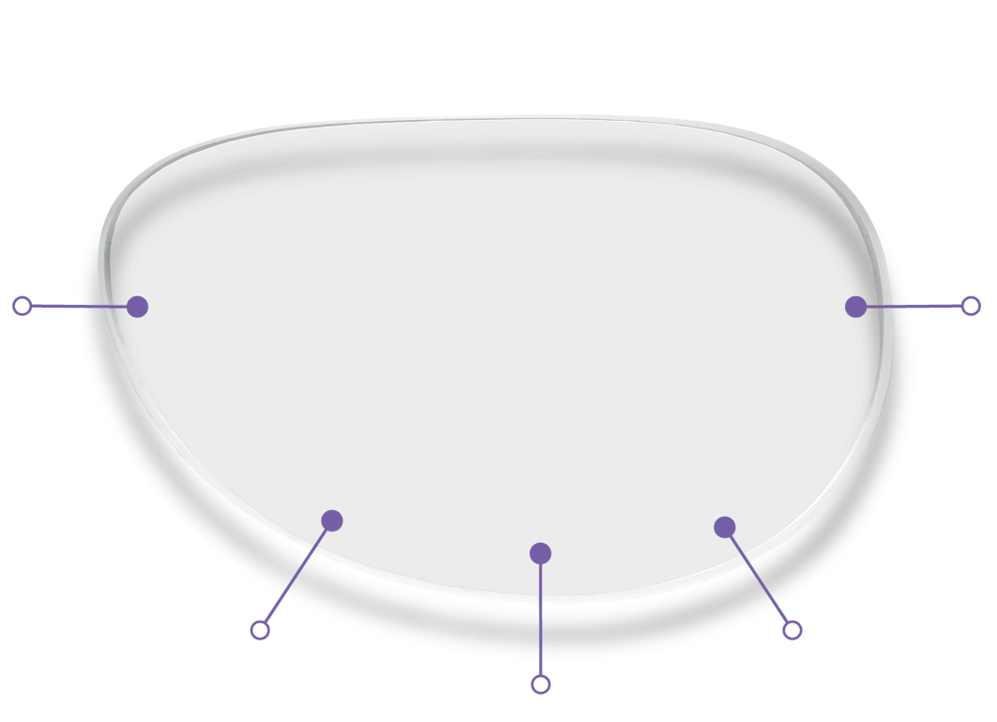
Smart Blue Filter™
Embedded protection against Harmful Blue Light in a clear lens.
Absorbs Harmful Blue Light by having protection that is embedded into the lens
Clear in color
and appearance
Transmits essential Blue-Turquoise Light (in the range between 465-495nm)
Reduces at least 20% of Harmful Blue Light
(in the range between 415-455nm).
No additional cost
NOT FOR DISTRIBUTION – DO NOT DISCLOSE OR COPY
Notes:
As you remember from my previous slide, there were two ways of reducing Harmful Blue Light in the past; tints or reflective protection. The Smart Blue Filter™ feature works on a new principle of absorption, and has embedded protection that is built into the lens to reduce at least 20% of harmful Blue Light. To reduce this light even more, Smart Blue Filter products should be combined with Crizal® Prevencia®. Together they will both absorb and reflect the light that is harmful to your patients’ eyes.

Slide 12
HARMFUL BLUE LIGHT
AMD is a condition that is not caught early and when caught it is irreversible
69% of people diagnosed are already late-stage
78% of people at initial diagnosis are 20/50 or worse
40% of people are 20/200 at initial diagnosis
Source:
*Arnault E. Barrau C, Nanteau C. Gondouin P, Bigot K, et al. “Phototoxic Action Spectrum on a Retinal Pigment Epithelium Model of Age-Related Macular Degeneration
Exposed to Sunlight Normalized Conditions.” PLoS ONE 8(*); e71398.doi:10.1371398.August 23,2013.
**National Institues of Health National Eye Institute. Facts about Age-Related Macular Degeneration. Retrieved from: https://nei.nih.gov/health/maculardegen/armd_facts
NOT FOR DISTRIBUTION – DO NOT DISCLOSE OR COPY
Notes:
At Essilor, we are committed to exploring the long term impact of prolonged exposure to Harmful Blue Light and will continue our research so that we can better understand its impact on the eye. One thing we know for sure, is that there are no beneficial effects of Blue-Violet Light.
We also know that harmful Blue Light has been linked to retinal disorders such as age-related macular degeneration (AMD), which is the leading cause of blindness for adults over the age of 50 in the US. There has been a lot of research and discussion regarding this topic in the optical industry, and there appears to be several contributing factors regarding macular degeneration including:
Age
Genetics
Long term exposure to Harmful Blue Light
Lifestyle (e.g. smoking)
Obesity
Lack of antioxidants in the daily diet

Slide 13



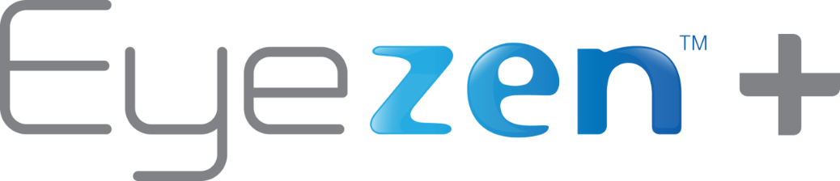
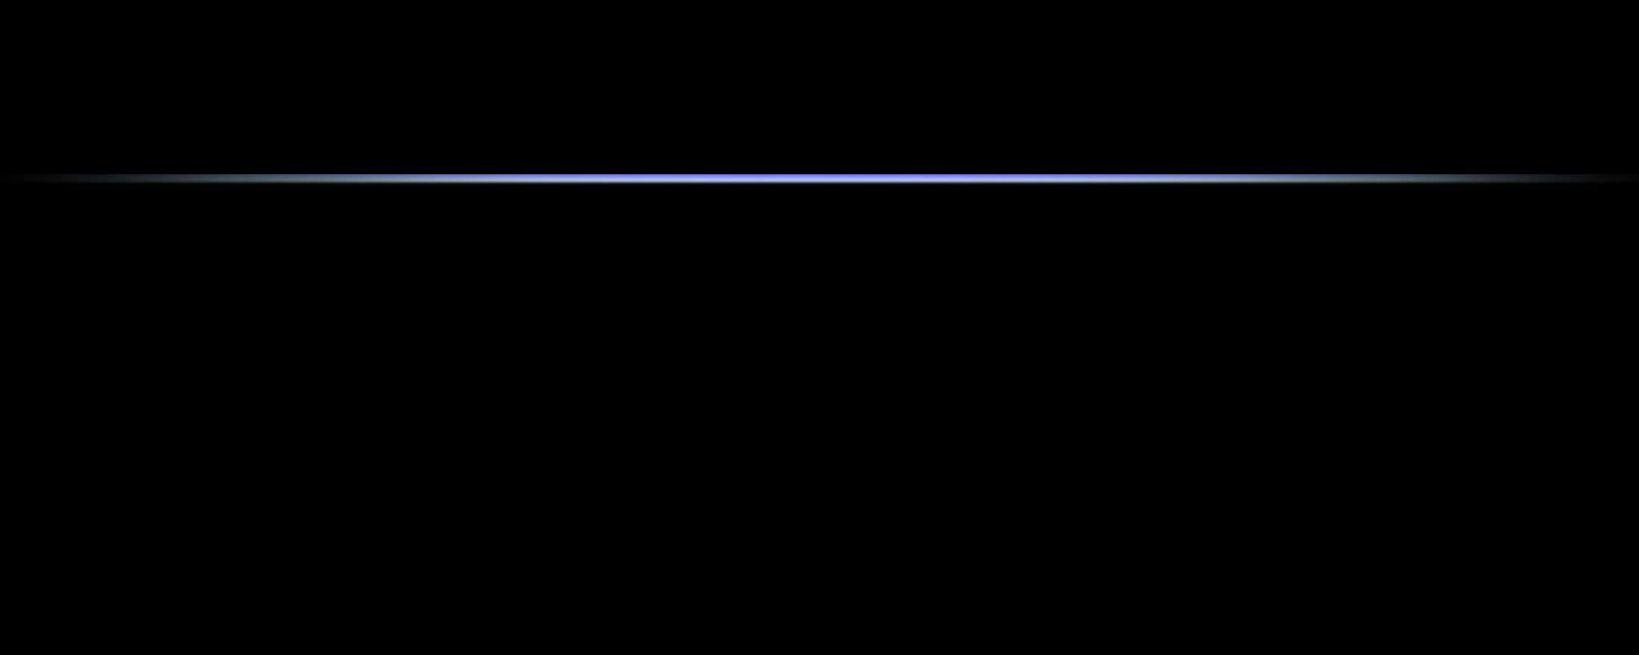
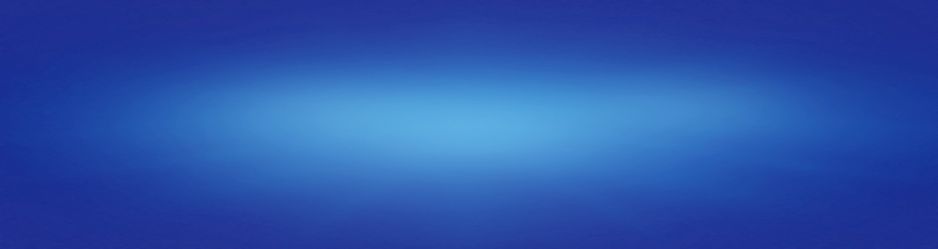
Smart Blue Filter™
Products
NOT FOR DISTRIBUTION – DO NOT DISCLOSE OR COPY
Notes:
Innovation from Essilor means that millions will have access to premium clear lenses that will block at least 20% of Harmful Blue Light. By connecting this feature with Essilor’s top brands, we’ve removed the barriers that typically prevent rapid adoption of new eye protection technologies.
Smart Blue Filter will be found within the following select premium products:
Varilux® Digital*, Eyezen+™, and Transitions® lenses.
This will reduce exposure to Harmful Blue Light for millions of wearers in the first year alone! Now, when you order a Varilux Digital*, Eyezen+ or Transitions lens, your patients will receive Smart Blue Filter at no additional price increase to you!
*all Varilux digital products except our Varilux Physio Enhanced & Varilux Comfort Enhanced designs

Slide 14

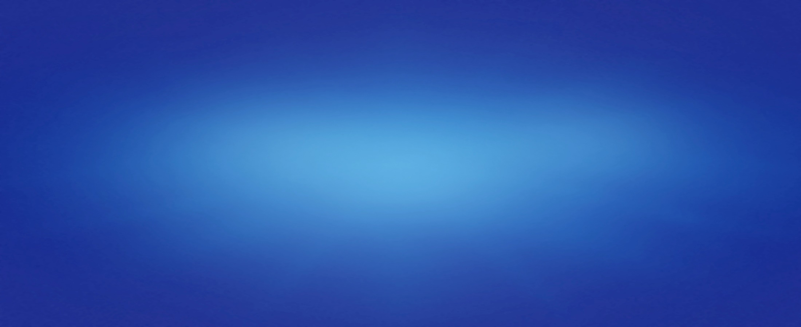
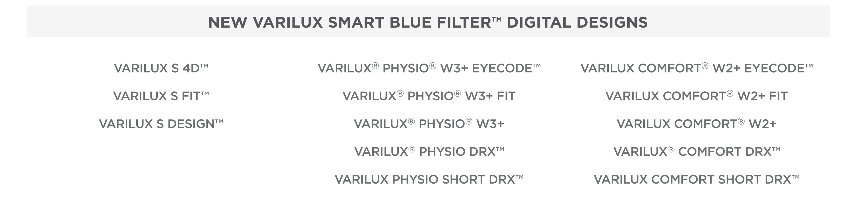
THE #1 PROGRESSIVE LENS BRAND will now
provide Harmful Blue Light protection at
NO ADDITIONAL COST TO YOU
  Driving innovation in the progressive lens category!
NOT FOR DISTRIBUTION – DO NOT DISCLOSE OR COPY
Notes:
Varilux®, the #1 progressive lens brand will now reduce Harmful Blue Light at no additional cost to you! Varilux progressive lenses provide sharp vision and smooth transitions at any distance. Since the first Varilux progressive lens was introduced in 1959, Varilux has been the innovation leader in the progressive lens category. The latest example, Smart Blue Filter™, will automatically come in all Varilux digital lenses, except the Varilux Enhanced designs and those that are traditionally surfaced.
What materials are launching April 19th?
1.50 Plastic, Airwear® Polycarbonate, Thin&Lite® 1.67
Later in 2016: Thin&Lite® 1.60, TREXA™ (Trivex®), Thin&Lite® 1.74
How to verify that you have received a Smart Blue Filter™ lenses:
There is no change in ordering systems for the new Varilux® Smart Blue Filter™ lenses, and there are no new engravings. To verify a Smart Blue Filter lens, we have asked all Lab Management Systems to include the letters SBF on the invoice/pack slip.

Slide 15

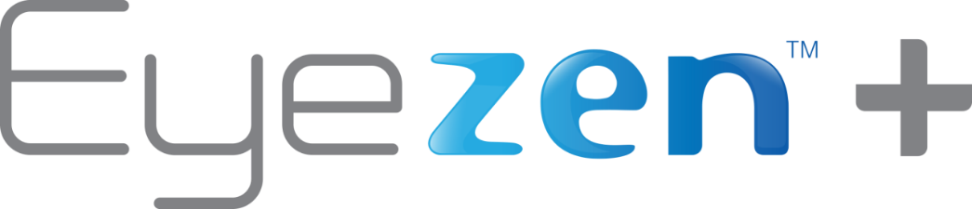
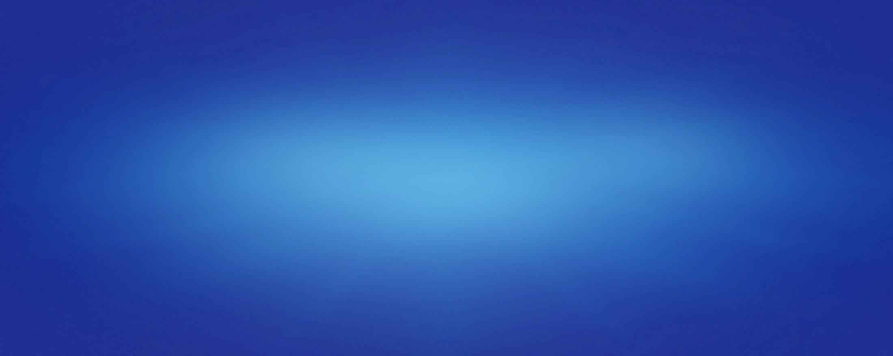
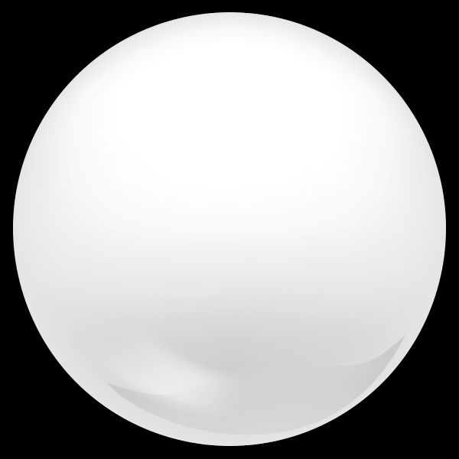
Essilor’s new, enhanced single vision solution that is backed by consumer advertising
  Eyezen™+ lenses alleviate digital eyestrain and reduce Harmful Blue Light
  All Eyezen™+ lens products will include the Smart Blue Filter™ feature
  Eyezen™+ lenses are an upgrade to standard single vision lenses
  Driving innovation in the single vision lens category!
NOT FOR DISTRIBUTION – DO NOT DISCLOSE OR COPY
Notes:
Beginning March 29th, Eyezen™+ lenses can help reduce your single vision patients exposure to Harmful Blue Light. Eyezen+ lenses contain a small amount of accommodative relief to alleviate eyestrain caused by viewing digital devices, and provide an enhanced single vision solution for patients complaining of eyestrain.
We are actively working with VSP, EyeMed and other MVC partners to achieve categorization as quickly as possible. In both cases, Eyezen+ will be categorized simply as a Digital SV offering (Note: VSP refers to their Digital SV category as Digital Aspheric SV).

Slide 16


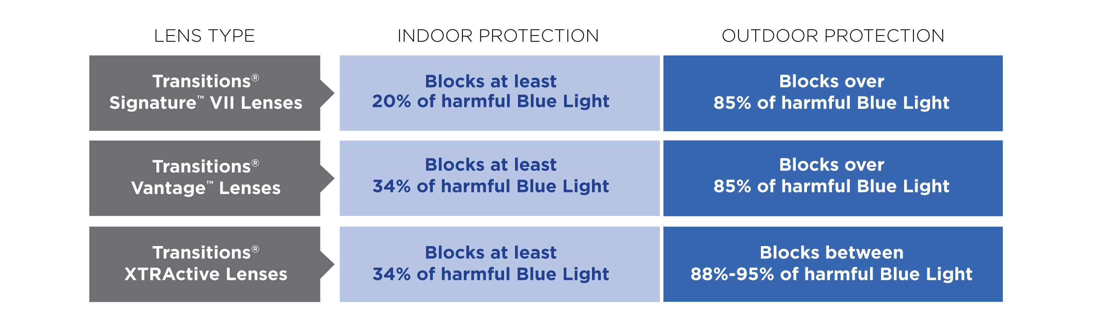
All Transitions® Lenses help protect eyes from
Harmful Blue Light, both inside and outside
Driving innovation in the adaptive lens category!
NOT FOR DISTRIBUTION – DO NOT DISCLOSE OR COPY
Notes:
Due to the increased use of digital devices today, Transitions is excited to share that this feature is a part of every Transitions® adaptive lens! Although this is not a new feature for Transitions lenses, we believe that it is important to talk about the Blue Light reduction benefits found in our lenses. By focusing on the comprehensive indoor and outdoor Blue Light filtering benefits, Transitions products are able to appeal to today’s modern lifestyle.
All Transitions lenses help reduce exposure to Harmful Blue Light under any and all lighting conditions. Indoors, Transitions lenses safeguard against Harmful Blue Light emitted by artificial sources like digital devices and LED lights, while outdoors they help provide extra protection from the sun by shielding eyes from glare, intense Harmful Blue Light, and UV rays.
While in the un-activated (clear) indoor state, the photochromic molecules found in Transitions lenses block at least 20% of Harmful Blue Light without compromising indoor vision clarity. Once activated (dark), Transitions lenses block up to 85% of Harmful Blue Light outdoors.
For patients at risk for AMD (those with a family history of AMD)- we recommend Transitions XTRActive adaptive lenses. Indoors they will block at least 34% of Harmful Blue Light, and between 88-95% of Harmful Blue Light outdoors.

Slide 17

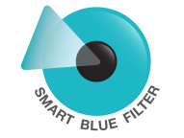
Smart Blue Filter Inside Protection
Smart Blue Filter Products
Harmful Blue Light Protection
Varilux® Digital*
Eyezen™+
Transitions® Signature™ VII
Blocks at least
HARMFUL
Blue Light
20%
Smart Blue Filter Products
Harmful Blue Light Protection
Transitions® XTRActive®
Transitions Vantage
34%
Blocks at least
HARMFUL
Blue Light
Combine with Crizal® No-Glare Lenses for the most comprehensive eye protection, and with Crizal® Prevencia® for the ultimate protection against harmful light.
* All Varilux Digital lenses except Varilux Physio Enhanced & Varilux Comfort Enhanced
**E-SPF® is a global index rating the overall UV protection of a lens. E-SPF was developed by Essilor International and endorsed by 3rd party experts. A lens rating of E-SPF 25 means that an eye protected by the lens will receive 25 times less UV exposure than without any lens. E-SPF of 25 when Crizal is made with any lens material other than clear 1.5 plastic.
NOT FOR DISTRIBUTION – DO NOT DISCLOSE OR COPY
Notes:
I know I’ve talked about a lot of Smart Blue Filter™ products, but when it comes to indoor clear lenses, there are 3 levels of protection:
Essential Level:
The first level reduces at least 20% of Harmful Blue Light with our Smart Blue Filter products, (Varilux® Digital, Transitions® VII, or Eyezen™+ lenses) and when combined with our Crizal UV No-Glare treatments, patients will also receive an E-SPF of 25.
2. Advanced Level:
The second level has advanced protection when Crizal Prevencia products are combined with the Smart Blue Filter products (Varilux Digital, Transitions VII, or Eyezen+ lenses). When this happens, Harmful Blue Light will be reduced by 30% and patients will have an E-SPF of 25.
3. Ultimate Level:
The third level provides the best indoor reduction of UV and Harmful Blue Light exposure. When Transitions XTRActive or Transitions Vantage Smart Blue Filter products are combined with a Crizal Prevencia No-Glare lens treatment, Harmful Blue Light is reduced by 45%, and patients will receive an E-SPF of 25.

Slide 18

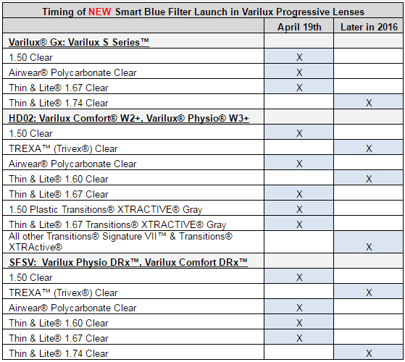
Product Availability
NOT FOR DISTRIBUTION – DO NOT DISCLOSE OR COPY

Slide 19
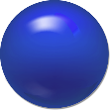
Summary
1
3
Offer Blue Light protection
to everyone
  The Smart Blue Filter™ feature will be automatically embedded within Varilux® Digital, Transitions®, and Eyezen™+ lenses. This will reduce exposure for millions of patients in the first year alone!
  Harmful Blue Light
  Harmful Blue Light has been linked to retinal disorders such as age-related macular degeneration (AMD)* which is the leading cause of vision loss in adults over the age of 50.**
2
  No price increase!
  Valuable innovation you can
  pass onto your patients
  Differentiation through superior
  eye care & brands
Source:
*Arnault E. Barrau C, Nanteau C. Gondouin P, Bigot K, et al. “Phototoxic Action Spectrum on a Retinal Pigment Epithelium Model of Age-Related Macular Degeneration
Exposed to Sunlight Normalized Conditions.” PLoS ONE 8(*); e71398.doi:10.1371398.August 23,2013.
**National Institues of Health National Eye Institute. Facts about Age-Related Macular Degeneration. Retrieved from: https://nei.nih.gov/health/maculardegen/armd_facts
NOT FOR DISTRIBUTION – DO NOT DISCLOSE OR COPY
Notes:
Essilor is investing millions of dollars to bring this innovation to the market. However, we will not be passing ANY of the expense onto you! We want to continue helping independent eyecare professionals like you to acquire new patients and to provide the support you need to help grow your business. One way we are showing our support is through innovative products like Smart Blue Filter and our new comprehensive level of protection- the Eye Protect System.

Slide 20
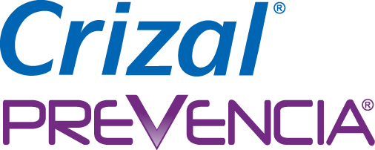
+
Protection
Against Harmful Light!
NOT FOR DISTRIBUTION – DO NOT DISCLOSE OR COPY
Notes:
When you combine Smart Blue Filter products with Crizal Prevencia, you will be providing your patients with an increased level of protection against Harmful Blue Light!

Slide 21
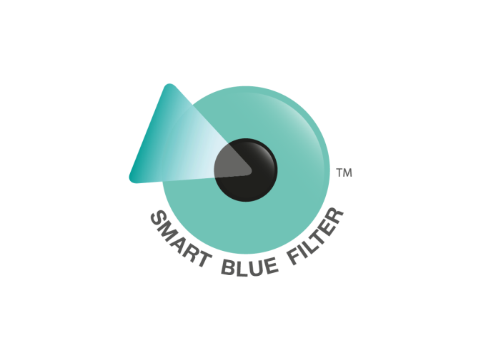
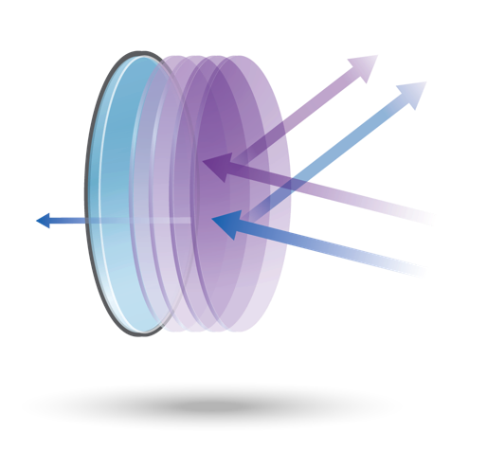
Smart Combination
Smart Blue Filter™ + Crizal® Prevencia®
Smart Blue Filter™ Embedded Protection
Crizal® Prevencia® No-Glare Lens Treatment
Together they
reduce Harmful
Blue Light by 30%
Allow essential
Blue-Turquoise Light
UV Light
Harmful Blue Light
*E-SPF® is a global index rating the overall UV protection of a lens. E-SPF was developed by Essilor International and endorsed by 3rd party experts. A lens rating of E-SPF 25 means that an eye protected by the lens will receive 25 times less UV exposure than without any lens. E-SPF of 25 when Crizal is made with any lens material other than clear 1.5 plastic.
NOT FOR DISTRIBUTION – DO NOT DISCLOSE OR COPY
Notes:
Combine with Crizal® Prevencia® for the increased protection against harmful light.

Slide 22
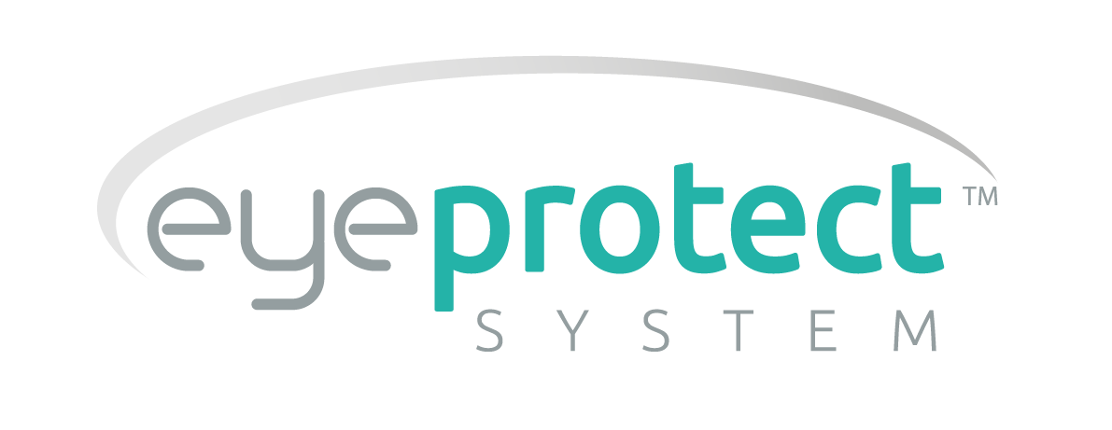
Eye Protect™ System
Inside Protection
Smart Blue Filter Products
No-Glare Lens Treatment
Harmful Blue Light Protection
UV Protection
Varilux® Digital*
Eyezen™+
Transitions® Signature™ VII
Crizal Easy UV
Crizal Alize UV
Crizal Avance UV
Crizal Sapphire UV
20%
Blocks at least
HARMFUL
Blue Light
ESSENTIAL
Varilux® Digital*
Eyezen™+
Transitions Signature VII
30%
Blocks at least
HARMFUL
Blue Light
ADVANCED
Crizal Prevencia
45%
Transitions® XTRActive®
Transitions Vantage
Crizal Prevencia
Blocks at least
HARMFUL
Blue Light
ULTIMATE
* All Varilux Digital lenses except Varilux Physio Enhanced & Varilux Comfort Enhanced
**E-SPF® is a global index rating the overall UV protection of a lens. E-SPF was developed by Essilor International and endorsed by 3rd party experts. A lens rating of E-SPF 25 means that an eye protected by the lens will receive 25 times less UV exposure than without any lens. E-SPF of 25 when Crizal is made with any lens material other than clear 1.5 plastic.
NOT FOR DISTRIBUTION – DO NOT DISCLOSE OR COPY
Notes:
I know I’ve talked about a lot of Smart Blue Filter™ products, but when it comes to indoor clear lenses, there are 3 levels of protection:
Essential Level:
The first level reduces at least 20% of Harmful Blue Light with our Smart Blue Filter products, (Varilux® Digital, Transitions® VII, or Eyezen™+ lenses) and when combined with our Crizal UV No-Glare treatments, patients will also receive an E-SPF of 25.
2. Advanced Level:
The second level has advanced protection when Crizal Prevencia products are combined with the Smart Blue Filter products (Varilux Digital, Transitions VII, or Eyezen+ lenses). When this happens, Harmful Blue Light will be reduced by 30% and patients will have an E-SPF of 25.
3. Ultimate Level:
The third level provides the best indoor reduction of UV and Harmful Blue Light exposure. When Transitions XTRActive or Transitions Vantage Smart Blue Filter products are combined with a Crizal Prevencia No-Glare lens treatment, Harmful Blue Light is reduced by 45%, and patients will receive an E-SPF of 25.

Slide 23
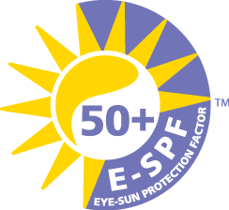
Eye Protect™ System
^{Outside Protection}
Smart Blue Filter Products
No-Glare Lens Treatment
Harmful Blue Light Protection
UV Protection
Transitions® Signature™ VII
Transitions® Vantage
Crizal Easy UV
Crizal Alize UV
Crizal Avance UV
Crizal Sapphire UV
Crizal Prevencia
85%
Blocks over
HARMFUL
Blue Light
Ultimate
(Activated)
Blocks over
HARMFUL
Blue Light
88%
Transitions® XTRActive
OUTDOOR Polarized
Blocks up to
HARMFUL
Blue Light
92%
Xperio UV™ Polarized Sun Lenses
* All Varilux Digital lenses except Varilux Physio Enhanced & Varilux Comfort Enhanced
**E-SPF® is a global index rating the overall UV protection of a lens. E-SPF was developed by Essilor International and endorsed by 3rd party experts. A lens rating of E-SPF 25 means that an eye protected by the lens will receive 25 times less UV exposure than without any lens. E-SPF of 25 when Crizal is made with any lens material other than clear 1.5 plastic.
NOT FOR DISTRIBUTION – DO NOT DISCLOSE OR COPY
Notes:
3. Ultimate Level (continued):
When activated (dark), Transitions® XTRActive® or Transitions® Vantage™ Smart Blue Filter™ products will reduce Harmful Blue Light between 85-88%!
We recommended this level of protection for patients who are at risk for AMD due to the fact that it will reduce the most amount of Harmful Blue Light.
The three levels we just spoke about can be worn both indoors, and outdoors- but for the best outdoor protection against Harmful Blue Light, recommend XperioUV polarized sun lenses. This recommendation will reduce between 87-92% of Harmful Blue Light and provide an E-SPF of 50!

